Slide 1
INF10025
Data Management and Analytics
Lecture 8 – Part 1
Modelling
M:M relationships
SQL: Outer Joins, SubQueries,
Unions, Views

Slide 2
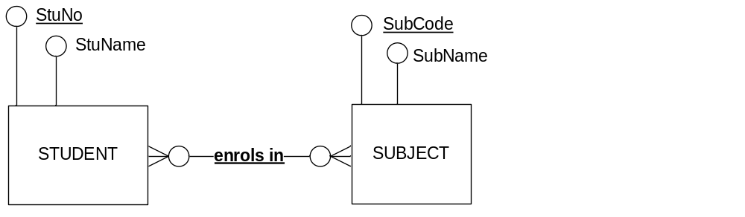
Many to Many relationships
Consider a M:M relationship
This M:M is perfectly valid in an ERD.
The relational model problem:
The Relational Model cannot directly represent a Many to Many (M:M) relationship
Instead this M:M must be converted to two M:1 relationships

Slide 3
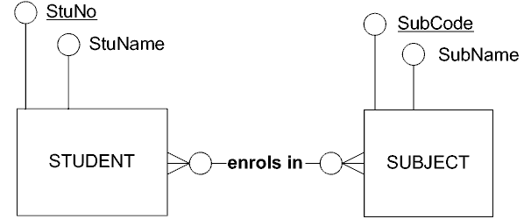
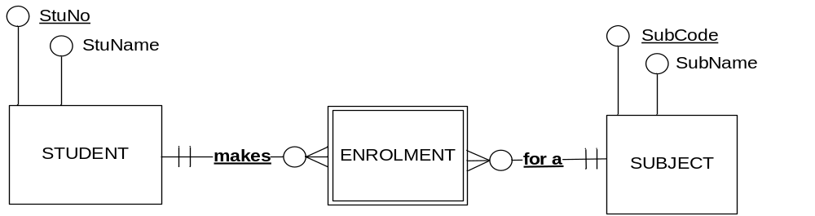
Convert M:M to 2 * M:1
The solution is to convert the single M:M relationship into two many-to-one relationships.
Erase the M:M
Draw a weak entity in its place with appropriate name.
Draw two M:1 relationships.
  The Many end of each relationship attaches to the weak entity
Underline the relationship names

Slide 4
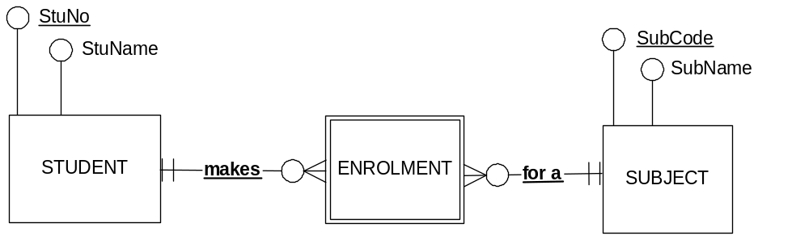
Many to Many expansion
What is the identifier of the Enrolment entity?
  Enrolment has no attributes of its own
  Enrolment is a weak entity so at least part of it's identifier is borrowed
  The relationship 'makes' is underlined.
    So borrow the identifier of Student
  The relationship 'for a' is underlined.
    So borrow the identifier of Subject
  The identifier of the Enrolment is StuNo + SubCode

Slide 5
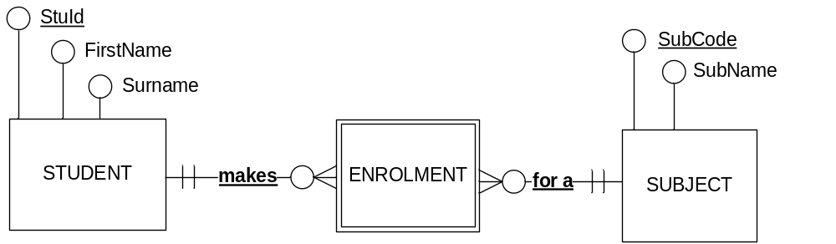
Many to Many expansion
stuId | firstname | surname
1122334 | Jane | Taylor
4444555 | Jobe | McKay
7777700 | Helen | Freeman
subcode | subname
INF10002 | DataBase Analysis…
INF20014 | Database Systems
INF30004 | Business Intelligence
subcode | stuId
INF10002 | 1122334
INF20014 | 1122334
INF10002 | 4444555
INF30004 | 4444555
INF10002 | 7777700
INF20014 | 4444555 …
  NOTICE:
  No restrictions on
  subjects-per-student
  If we add more subjects, then there in no change to the table designs
  NOTICE:
  No restrictions on
  students-per-subject
  If we add more students, then there in no change to the table designs

Slide 6
Intersection Entity
When a M:M is expanded, the new weak entity is
known as an Intersection Entity
  An Intersection Entity
    Has no additional attributes
    Is the result of expanding a M:M relationship (or Multi valued attribute)
Intersection Entity

Slide 7
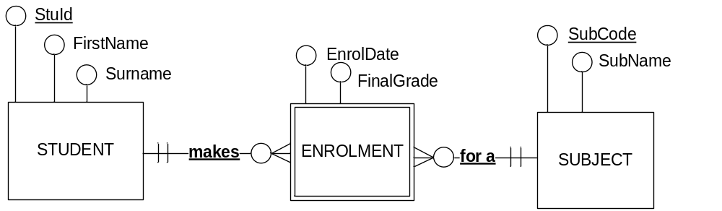
Many to Many expansion
stuId | firstname | surname
1122334 | Jane | Taylor
4444555 | Jobe | McKay
7777700 | Helen | Freeman
subcode | subname
INF10002 | DataBase Analysis…
INF20014 | Database Systems
INF30004 | Business Intelligence
subcode | stuId | enroldate | finalgrade
INF10002 | 1122334 | 28 Feb 2014 | HD
INF20014 | 7777700 | 28 Feb 2014 | P
INF10002 | 4444555 | 28 Feb 2014 | C
INF30004 | 4444555 | 15 Jul 2014 | P
INF10002 | 7777700 | 15 Jul 2014 | HD
INF20014 | 1122334 | 27 Feb 2015 | D

Slide 8
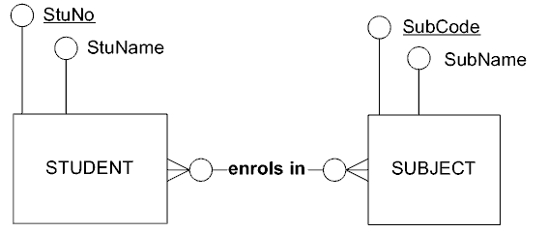
Unexpanded M:M relationships.
Unexpanded M:M relationships.
Advantages:
The weak intersection entity is hidden, therefore fewer entities.
Fewer entities means fewer relationships.
Results is a less cluttered diagram which is easier to read.
Relationship names have more useful descriptions
Disadvantages:
More difficult to determine how many tables will be generated
via schema conversion.
Weak entity is hidden,
so detail is lost.

Slide 9
Many to Many – not expanded
Sometimes ERDs are drawn as a form of documentation rather than as an aid to database design.
  Read / used by non database/IT people
  Both of the following ERDs are identical in the information that they provide
  Which of the following two ERDs is easier to:
    Read?
    Understand?
    Convert to Relational Schema?
  How many tables are generated by the 2nd ER Diagram?

Slide 10
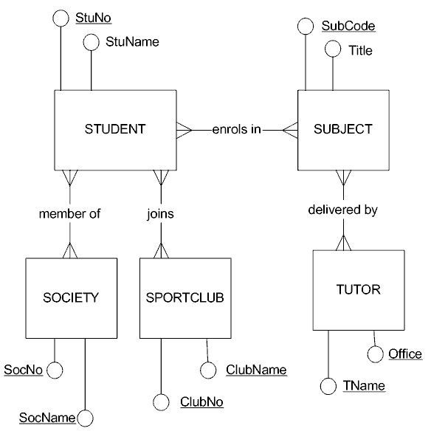
Many to Many – not expanded
Consider this ERD. Is it easy to Read? Understand? Convert to Schema?
Most non-database people
can easily understand this
ERD, after 30-60 seconds of
tuition about symbols

Slide 11
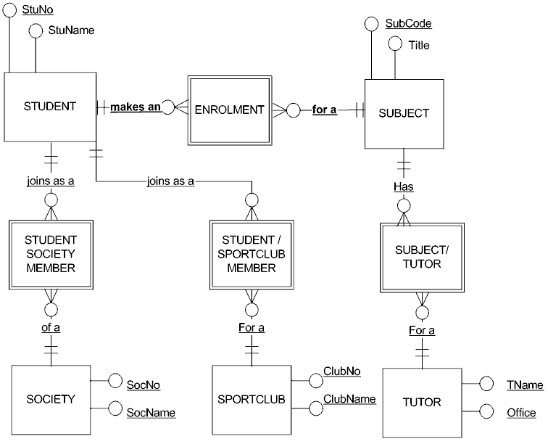
Many to Many - expanded
Consider this ERD. Is it easy to Read? Understand? Convert to Schema?
Most non-database people
find it difficult to understand
this ERD.
Symbols are more confusing.
What is the difference
between a student and a
student society member?
Why are they two different
entities?

Slide 12
Modelling: Designing your own ERDs
This lecture we will examine
  how to read and interpret a business narrative
  create and draw an ERD based on the narrative
You will be asked to create your own ERDs
  In tutorials
  In submission tasks

Slide 13
Steps involved in ERD design
Step 1 – Identify all Strong Entities and all Attributes
Step 2 – Assign attributes to the Strong Entities
Step 3 – Identify relationships
Step 4 – Determine cardinality and participation constraints
Step 5 – Attach remaining attributes to relationships
Step 6 – Expand M:M relationships with attributes
Step 7 – Attach attributes to appropriate entities or relationships
Step 8 – Determine identifiers
Step 9 – Test your solution.
      Create test data.
      Read the ERD aloud.
      Navigate the diagram.
      Think of how SQL queries would be written when the
      ERD is transformed into a database solution.

Slide 14
Identifying Entities
  ERD Entities:
    Each entity must have many instances
      "The Business" therefore is not an entity
    Singular noun (not verb). Written in Uppercase
    Use nouns specific to the Business
      Are you dealing with a customer or client or patron?
    May be a Strong Entity identified by its own attributes
      eg. StudentId
    May be a Weak Entity identified (wholly or partly) by attributes that are ‘borrowed’ from other entities
      eg. Enrolment

Slide 15
Identifying Attributes
ERD Attributes
    Each attribute is Identified by a single word or phrase
      use underscores or capitalisation to separate words
    Does not have properties of its own
      if it does, then its probably an entity
    An attribute is dependent on the identifier of the entity
      The value of StuAddress is dependant on the value of the identifier StudentId

Slide 16
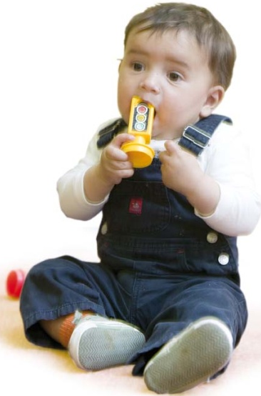
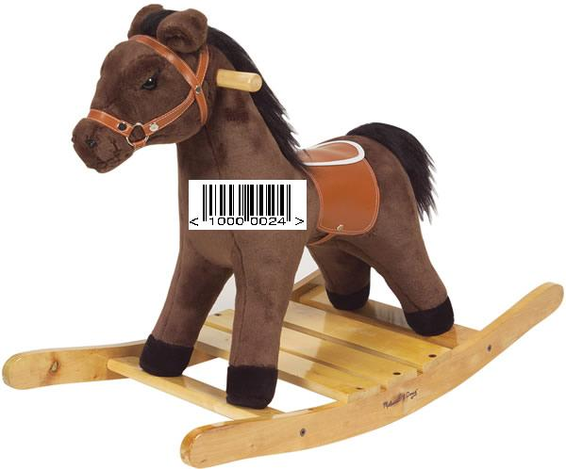


Glenferrie Toy Library Narrative
Sample Business Narrative:
Glenferrie Toy Library has many Patrons. A Patrons have a name and a gender. Each new Patron is assigned a sequential patron number. The library has a number of toys.
Every toy in the library has a unique toy number.
Each toy has a description and year of acquisition.
Each time a toy is loaned to a patron, the date of the loan is recorded. When the toy is returned, the returned date is recorded and the no. of days borrowed is determined.
Each loan is for a single toy.
Glenferrie Toy Library
Patron ID Card
Patron No: 12345678

Slide 17
Identify Entities and Attributes
Identify key elements such as Entities & Attributes
Element | Circle best alternative
Glenf. Toy Library | StrongEntity / WeakEntity / Attribute / Calculated / Ignore
Patron | StrongEntity / WeakEntity / Attribute / Calculated / Ignore
PatronNo | StrongEntity / WeakEntity / Attribute / Calculated / Ignore
Firstname | StrongEntity / WeakEntity / Attribute / Calculated / Ignore
Surname | StrongEntity / WeakEntity / Attribute / Calculated / Ignore
Patron Gender | StrongEntity / WeakEntity / Attribute / Calculated / Ignore
Toy | StrongEntity / WeakEntity / Attribute / Calculated / Ignore
ToyNo | StrongEntity / WeakEntity / Attribute / Calculated / Ignore
Description | StrongEntity / WeakEntity / Attribute / Calculated / Ignore
YearAquired | StrongEntity / WeakEntity / Attribute / Calculated / Ignore
DateBorrowed | StrongEntity / WeakEntity / Attribute / Calculated / Ignore
DateReturned | StrongEntity / WeakEntity / Attribute / Calculated / Ignore
DaysBorrowed | StrongEntity / WeakEntity / Attribute / Calculated / Ignore

Slide 18
Step 1 – Identify Strong Entities & Attributes
From the business narrative, identify Attributes and Strong Entities
PATRON
O PatronNo
O Firstname
TOY
O ToyNo
O Gender
O Description
O YearAquired
O DateBorrowed
O DateReturned
O Surname
This may seem like an un-necessary step, but it can be useful when dealing with an industry where many terms are foreign & unfamiliar

Slide 19
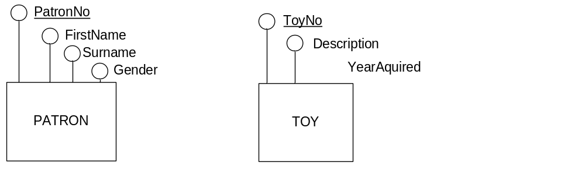
Step 2 – Attach attributes to entities
Attach attributes to Strong entities and underline identifiers

Slide 20
The DateBorrowed Attribute
To which entity (if any), should the DateBorrowed attribute be attached?

Slide 21
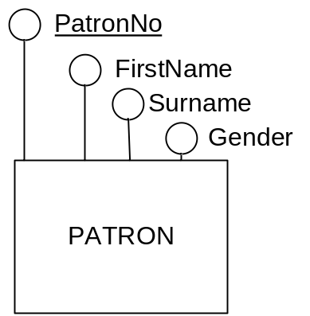
Consider an instance of a Patron
What does this diagram mean?
  PatronNo is the identifier.
    E.g. 53
  How many surnames does this patron 53 have?
    ONE E.g. Sofia Vegara
  How many genders does this patron 53 have?
    ONE E.g. Female

Slide 22
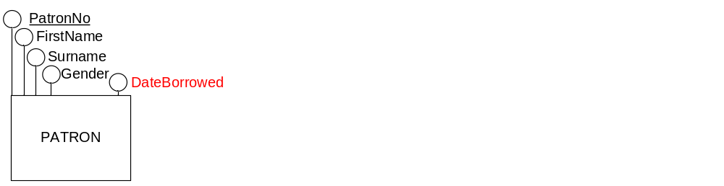
The DateBorrowed Attribute
So let's consider the DateBorrowed attribute:
What if it was added to the Patron Entity?
What would this diagram now mean?
  PatronNo is the identifier.
    Example: 53
  How many DateBorrowed values are allowed for patron 53?
    ONE e.g. 1 June
  This does not make sense! You would expect that a Patron
    Could borrow many times over many weeks.
    You would expect a patron to have many DateBorrowed values
  Therefore we can conclude that:
  DateBorrowed does not belong to the Patron Entity

Slide 23

The DateBorrowed Attribute
SO let's consider the DateBorrowed attribute:
What if it was added to the Toy Entity?
What would this diagram now mean?
  ToyNo is the identifier.
    E.g. T27
  How many DateBorrowed values are allowed for toy T27?
    ONE E.g. 15 Sept
    This does not make sense! You would expect that a Toy
    Will be borrowed many times over many weeks.
    You would expect a toy to have many DateBorrowed values
  Therefore we can conclude that:
  DateBorrowed does not belong to the Toy Entity

Slide 24
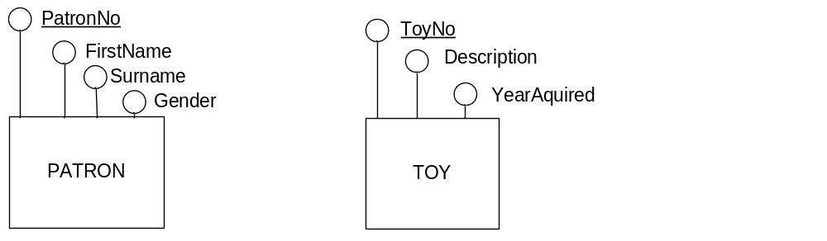
Step 2 – Attach attributes to entities
Some attributes simply don't belong to any of the strong entities.
Leave these attributes alone.
They will be dealt with in future steps of this process.
DateBorrowed
DateReturned

Slide 25
Step 3 - Identifying Relationships
Entities have relationships with other entities
  That's why they're called Entity Relationship Diagrams!
Use relevant verbs
  The relationship must be worth recording
  The relationship must persistent, not transient
      "The student enrolled in a subject"
      rather than
      "The student read the subject course finder web page"
  Watch for "abstract" nouns
      "A student makes an enrolment"
      is the same as
      "A student enrols in a subject".
  You should be able to verbalize the relationship
    eg. You can say "A Subject has many Enrolments"

Slide 26
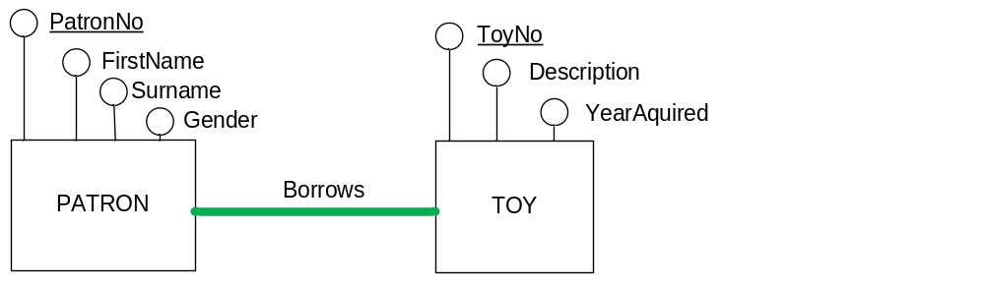
Step 3
Identify any relationships between entities
Easy in this diagram as there are only two entities!
    "A patron borrows toys"
So draw a line between the entities
DateBorrowed
DateReturned

Slide 27
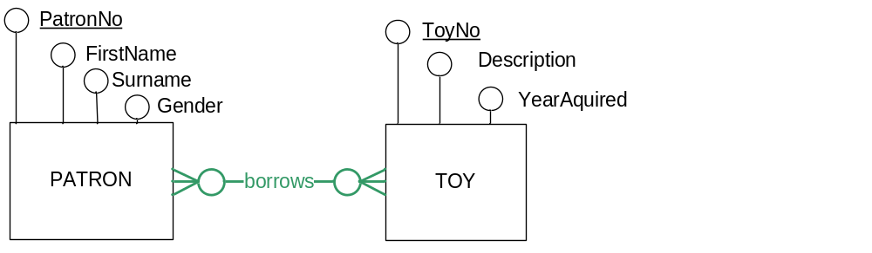
Step 4
Determine cardinality and participation constraints.
DateBorrowed
DateReturned

Slide 28
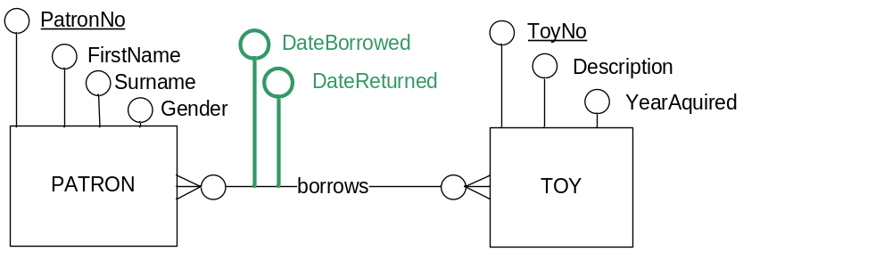
Step 5
Attach ALL remaining attributes to entities or relationships.
Ask yourself, does it make sense for the attributes to 'belong' to the relationship
After this step, all attributes must be attached to an entity or to a relationship.

Slide 29
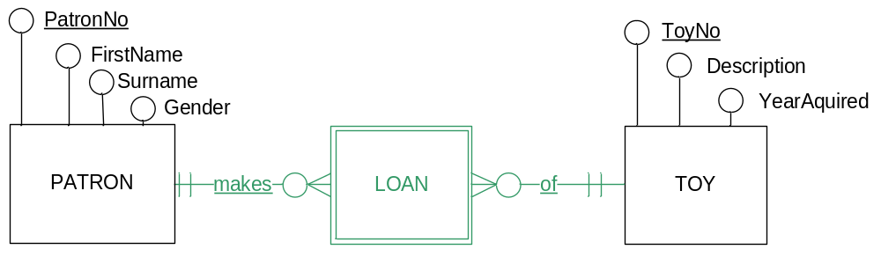
Step 6 – expand M:M with attributes
If your diagram now contains a M:M with attached attributes, then expand that M:M relationship
Expand M:M relationships that have attributes
DateBorrowed
DateReturned
Sometimes, during this process, you may discover more underlying M:M relationships, so you can't simply assume that the Dates will both belong to the Loan Entity.

Slide 30
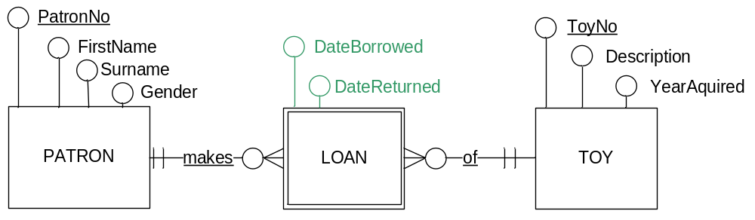
Step 7 – reattach attributes
Consider each outstanding attribute
  Does each Loan have a single DateBorrowed? (Yes)
  Does each Loan have a single DateReturned (Yes. It may be NULL)
  If an attribute belongs to an Entity, add it to the diagram

Slide 31
Identifiers…
What is the identifier of Loan?
If you are not sure, then a good approach is to create a relational schema and use some sample data…

